Slide 1
Automotive Regulations and Certification Processes:
Global Manufacturers’ Perspective
U.S. Automotive Industry Coalition Meeting
Andean/Mexico Delegation
December 7, 2016

Slide 2

World Without Regulatory Borders
We live in an increasingly interrelated and integrated world
Global automakers build and sell in markets across the world, promoting trade and investment
The ideal is to test once and sell anywhere, maintaining high levels of safety and environmental protection.
Notes:
We live in an increasingly interrelated and integrated world, but auto safety and environmental standards harmonization has lagged behind commercial reality
Global automakers build and sell in markets across the world, promoting trade and investment, but are increasingly running up against technical requirements that are well intentioned, but increase costs and inefficiencies without any meaningful benefit.
We as an industry can agree with the ideal: test once and sell anywhere, while simultaneously maintaining high levels of safety and environmental protection.
This would be a better fit with today’s commercial realities and be more efficient at the same time.

Slide 3
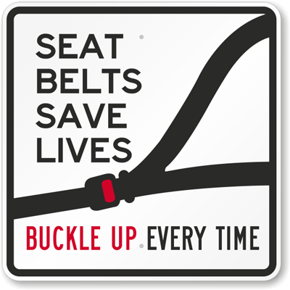
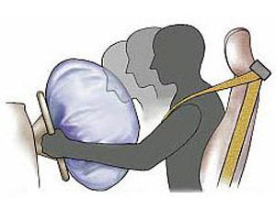
Automobile Safety & Environmental Impact
Governments everywhere are looking for ways to make their roads safer and reduce the impact on the environment associated with motor vehicles
Despite significant improvements- According to the United Nation’s World Health Organization, Road traffic injuries are the ninth leading cause of death globally, and the principal cause of death among those aged 15–29 years.
Notes:
Despite significant improvements- According to the United Nation’s World Health Organization, Road traffic injuries are the ninth leading cause of death globally, and the principal cause of death among those aged 15–29 years.
Governments have a imperative mission to protect their citizens and therefore are working to make their roads safer and reduce the impact on the environment and health associated with motor vehicles.

Slide 4
Safety Concept
Allocation of Responsibility
~90%
FAULT
DRIVER
Training / License
Age / Fitness / Renewal
INFRASTRUCTURE
Quality / Capacity
Repair / Grow
OPERATION
Limitations / Environment
Conditions / Rules
VEHICLE
Features / Attributes
Inspect / Maintain / Modify
SMALL %
Notes:
If you’re looking to increase safety regulations on vehicles plays only a small part. In fact the vast majority of the responsibility for safety lies with the driver, not the vehicle.
Government resources should also focus resources to improve the safety practices of the driver.

Slide 5




How to Address Societal Challenges
There are two major - equally robust sets of existing motor vehicle safety and environmental regulations
US Federal Motor Vehicle Safety Standards (FMVSS) and Environmental Protection Agency (EPA) rules
and,
UN Economic Commission for Europe (ECE) standards, now referred to as UN regulations under the 1958 Agreement
Notes:
To address these challenges, The United States and Europe have led the way in developing a comprehensive set of motor vehicle and environmental regulations. As such, they are the de facto internationally recognized auto standards.
In the U.S. this is governed by the US Department of Transpiration, National Highway Traffic Safety Administration, and the Environmental Protection Agency, and in Europe, it is overseen by the European Commission, Director General for Growth, whose members are the founders of the UNECE.
Both the US and ECE sets of regulations are EQUALLY ROBUST - with nearly identical performance and outcomes

Slide 6
Moving toward Global Technical Regulations (GTRs)
In 1998 the UN started to administer a new agreement specifically to develop harmonized Global Technical Requirements (GTRs) for motor vehicles and motor vehicle equipment.
UN GTRs provide a predictable regulatory framework for the global automotive industry, consumers and their associations. They do not contain administrative provisions for type approvals and their mutual recognition.
The 1998 Agreement has 34 contracting parties (19 if the EU and members are counted as one- in 2015). Both the U.S. and EU, as a single block, (one vote) are contracting parties to the ‘98 Agreement.
There are currently 16 GTRs that have been developed under the ‘98 Agreement:
  Twelve light duty standards/regulations,
  Three motorcycle standards
  One off-road emissions standard
  Under the ‘98 Agreement there are currently no certification or CoP provisions. Those are left up to each contracting party.
Notes:
The 1998 Agreement has 34 contracting parties and continues to grow. Both the U.S. and EU (as a single block-one vote) are contracting parties to the ‘98 Agreement.
There are currently 16 GTRs that have been developed under the ‘98 Agreement
Seven safety regulations and,
Four environmental regulations
Under the ‘98 Agreement there is currently no certification or conformity of production provision. Those are left up to each contracting party.
One important note is that the WP.29 recently agreed on long overdue refomr to the 1998 agreement procedures that are hoped to make the agreement more robust and meaningful.

Slide 7
Why Accept U.S. & ECE/EU
Certified Vehicles?
While work continues to develop more GTRs, and flaws in the GTR development process are fixed, it is strongly recommended that economies maintain regulatory policy that accepts vehicles for sale in the region that meets both ECE/EU and U.S. regulations.
FOUR PRIMARY REASONS:
1. Both are Robust, Long-standing & Tested
Both regulatory regimes have been developing safety and environmental regulations for over 40 years.
Both systems use technical assessment of real-world data as the basis for regulatory development.
Both sets of regulations cover active and passive safety, along with environmental emission control, which lead to state-of-the-art technology to meet their mandated levels of performance.
Notes:
There are five basic reasons we recommend why economies should accept both FMVSS and ECE regulations.
Work continues to develop more GTRs and to address the flaws in the GTR development presses. In the meantime, it is strongly recommended that economies maintain regulatory policy that accepts vehicles for sale in the region that meets either ECE or FMVSS/EPA regulations
First, Both are Robust, Long-standing & Tested
Both regulatory regimes have been developing safety and environmental regulations for over 40 years.
Both systems use technical assessment of real-world data as the basis for regulatory development.
Both sets of regulations cover active and passive safety along, with environmental emission control, which lead to state-of-the-art technology to meet their mandated levels of performance.

Slide 8



Comparable Performance
2. Both Have Comparable Performance & Outcomes
For each comparable FMVSS and ECE auto regulation, some technical differences are certain but that should NOT be the focus.
Instead, we should be aware that there are far more similarities in the objectives and outcomes for both regulatory schemes.
Notes:
The second reason why economies should accept both ECE and FMVSS/EPA standards is:
Both Have Comparable Performance & Outcomes
Although some technical differences are certain but that should NOT be the focus. Instead, the focus should be that there are far more similarities in the objectives and outcomes for both regulatory schemes.

Slide 9
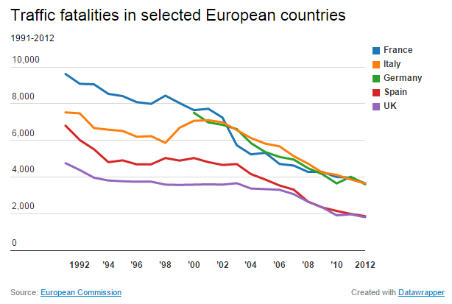
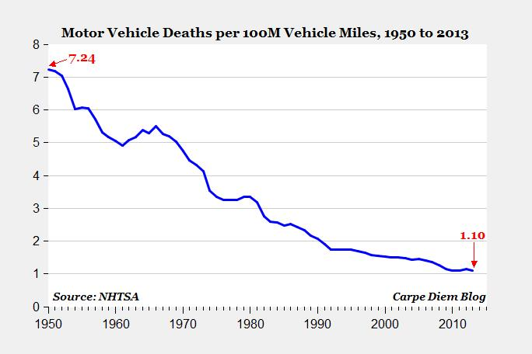
Comparable Performance
Real-world data demonstrates the comparable levels of performance resulting from ECE or U.S. safety and environmental regulations.
Various data sets shows that with regards to safety, the EU and US sets of automotive regulations offer the same high-level of performance and outcomes.
For auto emissions, both the EU’s “Euro 5”/ECE R83.06 and US’s “Tier 2” have similar requirements.
Europe
United States
Notes:
Various data sets are available that provide insight into the safety of vehicles built for sale in Europe and those built for sale in the United States.
Overall, this data shows that with regards to safety, the EU and US sets of automotive regulations offer the same high-level of safety performance and outcome. And as the charts demonstrate, fatalities in both Europe and the US have dropped significantly over time
It is important to note that a new driver related problem has emerged- distracted driving. It now contributes to one out of 10 fatal accidents in the United States.
For auto emissions, both the EU’s “Euro 5”/ECE R83.06 and US’s “Tier 2” have specific requirements for cold start and run conditions, evaporative emissions, system durability, low temperature performance and an onboard self-diagnostic system (OBD).

Slide 10
High Misalignment Cost ¥ € ₩ ₤ $
3. Reduces Cost and Increases Efficiency
A 2016 study conducted by the U.S. Based Center for Automotive Research (CAR) assessed the costs of having to meet the divergent auto safety regulations entitled: Potential Cost Savings and Additional Benefits of Convergence of Safety Regulations between the United States and the European Union.
It concluded that having to meet two different sets of safety standards significantly drive-up costs with no meaningful benefits and the savings realized if full U.S.-EU auto safety regulatory convergence was achieved - totaled $2.3 billion (up to $1,150 per car), but on a global basis, the extra saving rises to as much as $4.2 billion annually.
A 2015 study conducted by Peterson Institute for International Economics assessed the costs of having to meet both the U.S. and EU auto regulations (all regulations) entitled: Gains from Harmonizing US and EU Auto Regulations under the Transatlantic Trade and Investment Partnership.
The study concludes that regulatory convergence or mutual recognition of regulations between the EU and the U.S. would result in national income gains for both partners together of over $20 billion per year in the long run.

Slide 11











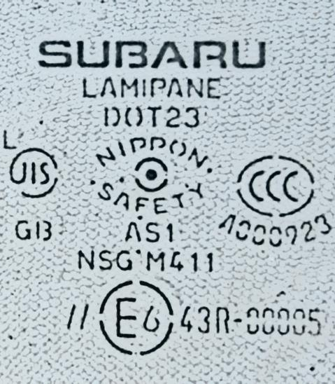
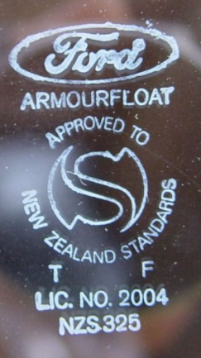
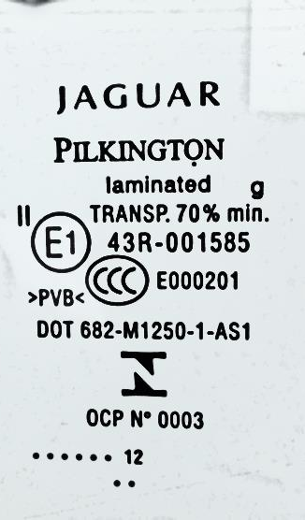
Different Markings
Different Marking Requirements
(Auto glass example)
E / e marks – EU
CCC mark – China
KC mark – Korea
TISI mark – Thailand
DOT mark – USA
SABS mark – S. Africa
JIS mark – Japan
AS mark – Australia
S mark – NZ
BS mark – British
Inmetro mark– Brazil
US DOT
Notes:
Unique National Requirements:
Having sets of different global auto standards is difficult and costly for global automakers to meet.
When the number of unique standards and regulations global automakers face around the world is added in, the cost and burden is exponentially increased.

Slide 12
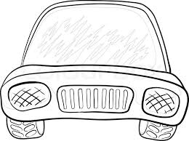











I can’t see anything… but I feel safe!
And don’t mention lights or mirrors!!
US DOT
GLOBAL CAR

Slide 13


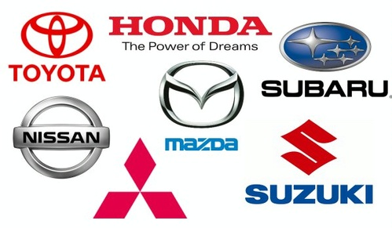








Consumer Benefits
4. Brings Consumer Benefits
Increased choices for consumers.
Cost savings & efficiencies that can be passed on to consumers.
Proliferation of new technologies- more kinds and more rapidly.
ADVANCED TECHNOLOGY
Notes:
The fourth reason why economies should accept both FMVSS and ECE regulations is the considerable benefits to consumers:
Increased choices for consumers- if only one set off standards is allowed, there will be fewer vehicle options available to the consumer, since not all vehicles are built to meet both sets of standards.
Cost savings & efficiencies that can be passed on to consumers- as discussed above, eliminating the high cost of misalignment would lead to lower costs, that can be passed along to the consumer.
Proliferation of new technologies- more kinds and more rapidly- no single company, industry or economy has a monopoly on new and advanced technologies, so by allowing acceptance of both sets of standards, you open the door to more opportunities for the introduction of new technologies

Slide 14
Countries that Accept Both
FMVSS & UN ECE
Examples of countries that accept both:
Argentina
Australia
Bahrain
Costa Rica
Dominican Republic
El Salvador
Ecuador
Guatemala
Honduras
Israel
Kuwait
Mexico
Morocco
New Zealand
Oman
Panama
Qatar
Sub-Sahara Africa (most 25+)
Saudi Arabia
South Korea
United Arab Emirates
Etc…

Slide 15
Type Approval & Self-Certification
Type Approval & Self-Certification
Type Approval & Self-Certification
It is not just about different standards/regulations, but also about the certification process- specifically- type approval and self-certification processes.
  The principle difference between the two is the requirement that for type approval the certification tests are witnessed by a government authority pre-market, and for self-certification these same types of tests are conducted by the vehicle manufacturer, with post-market follow-up verification by a government authority.
  In both cases data is generated to support the claim that a product meets or exceeds the technical performance requirements of any regulation.
Notes:
\

Slide 16
Type Approval & Self-Certification
Type Approval & Self-Certification
Self-Certification
Post-Sale Verification
The U.S. self-certification system uses a rigorous and robust post-sale verification system, which has helped U.S. regulators uncover defects that went undetected under other approaches.
Post-manufacture and sale, NHTSA independently buys vehicles from dealers and tests them at NHTSA’s facilities (44 products per year).
This assures that tested vehicles have not been altered, and are the same vehicles marketed to the public.
As a result, automakers often build in wider “compliance margins” to be certain that every vehicle coming off the production line will pass NHTSA and EPA’s random post-market tests.
NHTSA’s unified /robust post-sale monitoring system allows it to collect and analyze national data to quickly & accurately identify safety & accident trends.
These factors are why most of the wider-reaching recalls in recent automotive history originated in the U.S. (e.g., fuel efficiency non-compliance, sudden acceleration, and ignition switch malfunctions, and many more).

Slide 17
NHTSA’s Blue Ribbon Letter Program
We also recommend that countries accept vehicles that are certified through both type approval and self-certification procedures.
In the U.S., automakers test vehicles and certify that they meet FMVSS.
The Blue Ribbon Letter Program gives partner countries assurance from NHTSA that automotive products tested and certified by automakers are subject to the highest standard safety compliance process in the U.S., including NHTSA’s robust verification program and enforcement authority.
Under the program, NHTSA affirms that the manufacturer self-certifies that its product meets all applicable NHTSA requirements at the time of production.
The Blue Ribbon letter is an official, legal document available for products sold in the U.S. market and thus subject to NHTSA’s compliance authority.
Firms requesting the Blue Ribbon letters may be required by NHTSA to provide supporting documentation, including test results.

Slide 18
Conclusion
Automakers offer a diversity of automotive products and technologies, from around the world.
As we move toward a globally harmonized vehicle regulatory process through the WP-29 1998 agreement, we recommend facilitating both UNECE and FMVSS/EPA compliant vehicles.
A regulatory policy that accepts vehicles for sale in the region that meet both sets of safety and environmental regulations and certification processes offers many benefits:
  Such a policy will meet the highest safety and environmental standards;
  Offers state-of-the-art technologies from around the world;
  Provides consumers with a greater variety of products at a lower cost;
  Avoids disruption of significant automotive trade.

Slide 19
Status: Mexico, Ecuador & Colombia
MEXICO:
Has served a global model for flexibility on how automakers meet safety and environmental regulations. Mexico accepts vehicles certified to both UNECE, and FMVSS standards/regulations as well as vehicles certified through type approval and self-certification systems.
ECUADOR:
Ecuador should be applauded for recently deciding to accept UNECE, FMVSS, CVMSS, and other comparable standards as sufficient to meeting the automotive safety requirements in Ecuador.
Ecuador has also agreed to accept the Blue Ribbon Letter to meet the third party validator requirement for vehicles utilizing self-certification.
New challenges have emerged, including a call for meeting a higher level of auto emissions (equivalent to Euro-3), and concern that sufficient time be allowed to meet those requirements, and meet certain crash test ratings.
COLOMBIA:
As Colombia continues to make its planned changes to its auto standards, testing requirements, and certification procedures, we encourage the authorities to look to Ecuador and Mexico as models.

Slide 20
Thank You
? Questions ?

Slide 21
BACKUP SLIDES

Slide 22
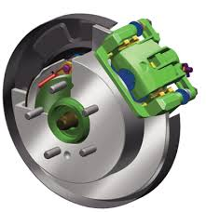
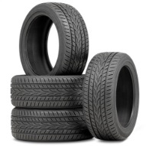
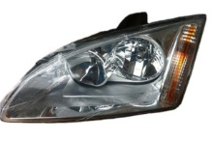
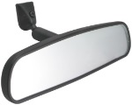
Comparable Crash Avoidance
Safety Regulations
US regulation | UN-ECE regulation
FMVSS No. 109 - New Pneumatic Tires | R 30- Pneumatic Tires (Passenger Vehicle) R 54- Pneumatic Tires (Commercial Vehicles )
FMVSS No. 111 - Rearview Mirrors | R 46- Rear View Mirror
FMVSS No. 114 - Theft Protection | R 18- Protection Against Unauthorized Use (M,N)
FMVSS No. 118 - Power-Operated Window, Partition, and Roof Panel Systems | R 21-Interior fittings
FMVSS No. 124 - Accelerator Control Systems | R 89-Speed limitation devices
FMVSS No. 129 - New Non-Pneumatic Tires for Passenger Cars | R 30- Pneumatic Tyres (Passenger Vehicle)
FMVSS No. 135 - Light Vehicle Brake Systems | R 13- Braking System R 13-H- Braking System (Passenger Car)
FMVSS No. 138 – Tire Pressure Monitoring System | R 64- tires- temp use or spare
FMVSS No. 139 – New Pneumatic Radial Tires | R 117-tires noise and wet grip
FMVSS No. 101 - Controls and Displays | R 39-Speedometer R 121- Hand controls, tell-tales and indicators
FMVSS No. 102 - Transmission Shift Lever Sequence, Starter Interlock, and Transmission Braking Effect | R 35- Foot Controls R 116- Unauthorized use (anti-theft & alarm systems)
FMVSS No. 108 - Lamps, Reflective Devices, and Associated Equipment Includes requirements for: Headlamps Reflecting devices Rear license Plate Lamps Direction Indicators Front and Rear Position Lamps Stop Lamps, End-outline Marker Reversing Lamps Installation of Lightings Side-marker Lamps | R 1 ,2, 5, 113 - Asymmetric headlamps R 3- Retro reflecting devices R 4- Rear Registration Plate Lamps R 6- Direction Indicators R 7- Front and Rear Position Lamps, Stop Lamps, End-outline Marker R 8, 20, 31- Halogen Headlamps R 19, 38 - Front and Rear Fog Lamps R 23- Reversing Lamps R 37- Filament Lamps R 45-Headlamp Cleaners R 48- Installation of Lightings R 77- Parking Lamps R 87- Daytime running lamps R 91- Side-marker Lamps R 98, 99- Gas-Discharge Headlamps R 104- Retro Reflective markings (hvy & long veh.) R 112- Headlamp R 119- Cornering lamps R 123- Adaptive Front Lighting System R 128- Light Emitting Diode (LED light sources

Slide 23
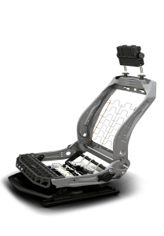
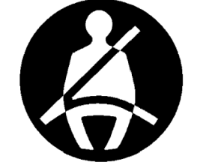
Comparable Crash Worthiness
Safety Regulations
US regulation | UN-ECE regulation
FMVSS No. 201 - Occupant Protection in Interior Impact | R 21-interior fittings
FMVSS No. 202 - Head Restraints (aligned with Global Technical regulation No. 7) | R 17- Seats R 25- Head Restraints R 32- Rear End Collision
FMVSS No. 203 - Impact Protection for the Driver from the Steering Control System | R 12- Steering Mechanism
FMVSS No. 205 - Glazing Materials (aligned with Global technical regulation No. 6) | R 43- Safety Glazing Material
FMVSS No. 206 - Door Locks and Door Retention Components (aligned with Global technical regulation No. 1) | R 11- Door Latches and Hinges
FMVSS No. 207 - Seating Systems | R 17- Seats R 80- Seats (Large Passenger Vehicle)
FMVSS No. 208 - Occupant Crash Protection | R 33- Head-on Collision R 94- Protection of the Occupants in the Event of Frontal Collision
FMVSS No. 209 - Seat Belt Assemblies | R 16- Seat Belt R 44- Child restraint systems
FMVSS No. 210 - Seat Belt Assembly Anchorages | R 14- Safety Belt Anchorages R 16- Safety Belts
FMVSS No. 214 - Side Impact Protection | R 95- Protection of the Occupants in the Event of Lateral Collision
FMVSS No. 225 – Child Restraint Anchorage Systems | R 14- Safety Belt Anchorages R 16- Safety Belts R 44- Child restraint systems
Notes:
Walk through the details of this chart.

Slide 24

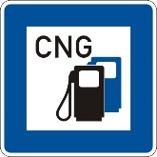
Comparable Post Crash & Other
Safety Regulations
Post Crash US regulation | Post Crash UN-ECE regulation
FMVSS No. 301 - Fuel System Integrity | R 34- Fire risks
FMVSS No. 303 - - Fuel System Integrity of Compressed Natural Gas Vehicles | R 34 – Fire risks R 110- Vehicles using CNG
FMVSS No. 304 - Compressed Natural Gas Fuel Container Integrity | R 110- Vehicles using CNG
FMVSS No. 305 – Electric-powered Vehicle: electrolyte spillage and electrical shock protection | R 100- Electric Vehicle battery- crash provisions
Other US regulation | Other UN-ECE regulation
Given the proprietary nature of the vehicle electrical architecture, in the US each vehicle manufacturer conducts their own series of tests for EMC. NHTSA continues to study the need for standardization in this area but no safety need has yet been established | R 10- Uniform provisions concerning the approval of vehicles with regard to electromagnetic compatibility
This is now a GTR which should be seen as superseding R 26. The US is currently in rulemaking to adopt the GTR. The need for smooth aerodynamic exteriors to meet fuel economy demands have resulted in exterior designs that meet the intent of R 26. | R 26-Uniform provisions concerning the approval of vehicles with regard to their external projections
Various state laws that mandate a horn on any motor vehicle operating on their roadways, making a de facto federal law. The standard fitment of a horn is also recognized in FMVSS 101 by its required identification in that regulation. | R 28 -Uniform provisions concerning the approval of audible warning devices and of motor vehicles with regard to their audible signals
Steering equipment as a standard fitment is recognized by the crash protection requirements for controlling steering system intrusion that are contained in FMVSS 204 | R 79 - Uniform provisions concerning the approval of vehicles with regard to steering equipment
FMVSS 114 specifies requirements for theft protection in the US. NHTSA is studying the effectiveness of immobilizers on reducing auto theft. | R 97- Uniform provisions concerning the approval of vehicle alarm systems (VAS) and of motor vehicles with regard to their alarm systems (AS)
Notes:
Walk through the details of this chart.

Slide 25
Current GTRs (2016)
Global Technical Regulations (GTR) under the 1998 Agreement (16, with 12 for light-duty vehicles)
#1 - Doors locks and door retention components
#2 - Measurement procedure for two-wheeled motorcycles equipped with a positive or compression ignition engine with regard to the emission of gaseous pollutants, CO2 emissions and fuel consumption
#3 - Motorcycle brake system
#4 - Test procedure for compression-ignition engines and positive-ignition engines fuelled with natural gas or liquefied petroleum gas with regard to the emission of pollutants
#5 - Technical requirements for on-board diagnostic systems (OBD) for road vehicles
#6 - Safety glazing materials for motor vehicles and motor vehicle equipment
#7 - Head restraints
#8 - Electronic stability control systems
#9 - Pedestrian safety
#10 - Off-cycle emissions
#11 - Test procedure for compression-ignition engines to be installed in agricultural and forestry tractors and in non-road mobile machinery with regard to the emissions of pollutants by the engine
#12 – Concerning the location, identification, and operation of motorcycle controls, telltales and indicators
#13 – Global technical regulation on hydrogen and fuel cell vehicles
#14 – Pole Side Impact
#15 – Worldwide harmonized Light vehicle Test Procedures (WLTP)
#16 - Tires
Light Duty
Motorcycle
Off-road
Notes:
Since 1998, there have only been 16 regulations developed and agreed.
Flaws with GTR process:
Slow to develop (Consensus)
Once agreed, not required to adopt, and
When adopted, often modifications are made by countries
Work is underway to address these flaws…..but in the meantime…. it is strongly recommended that countries in the ASEAN region accept both US and ECE

